Slide 1



FIFA PLAYERS ANALYSIS USING POWER BI
View in Power BI
Last data refresh:
6/14/2021 9:45:06 AM UTC
Downloaded at:
6/14/2021 10:25:22 AM UTC

Slide 2
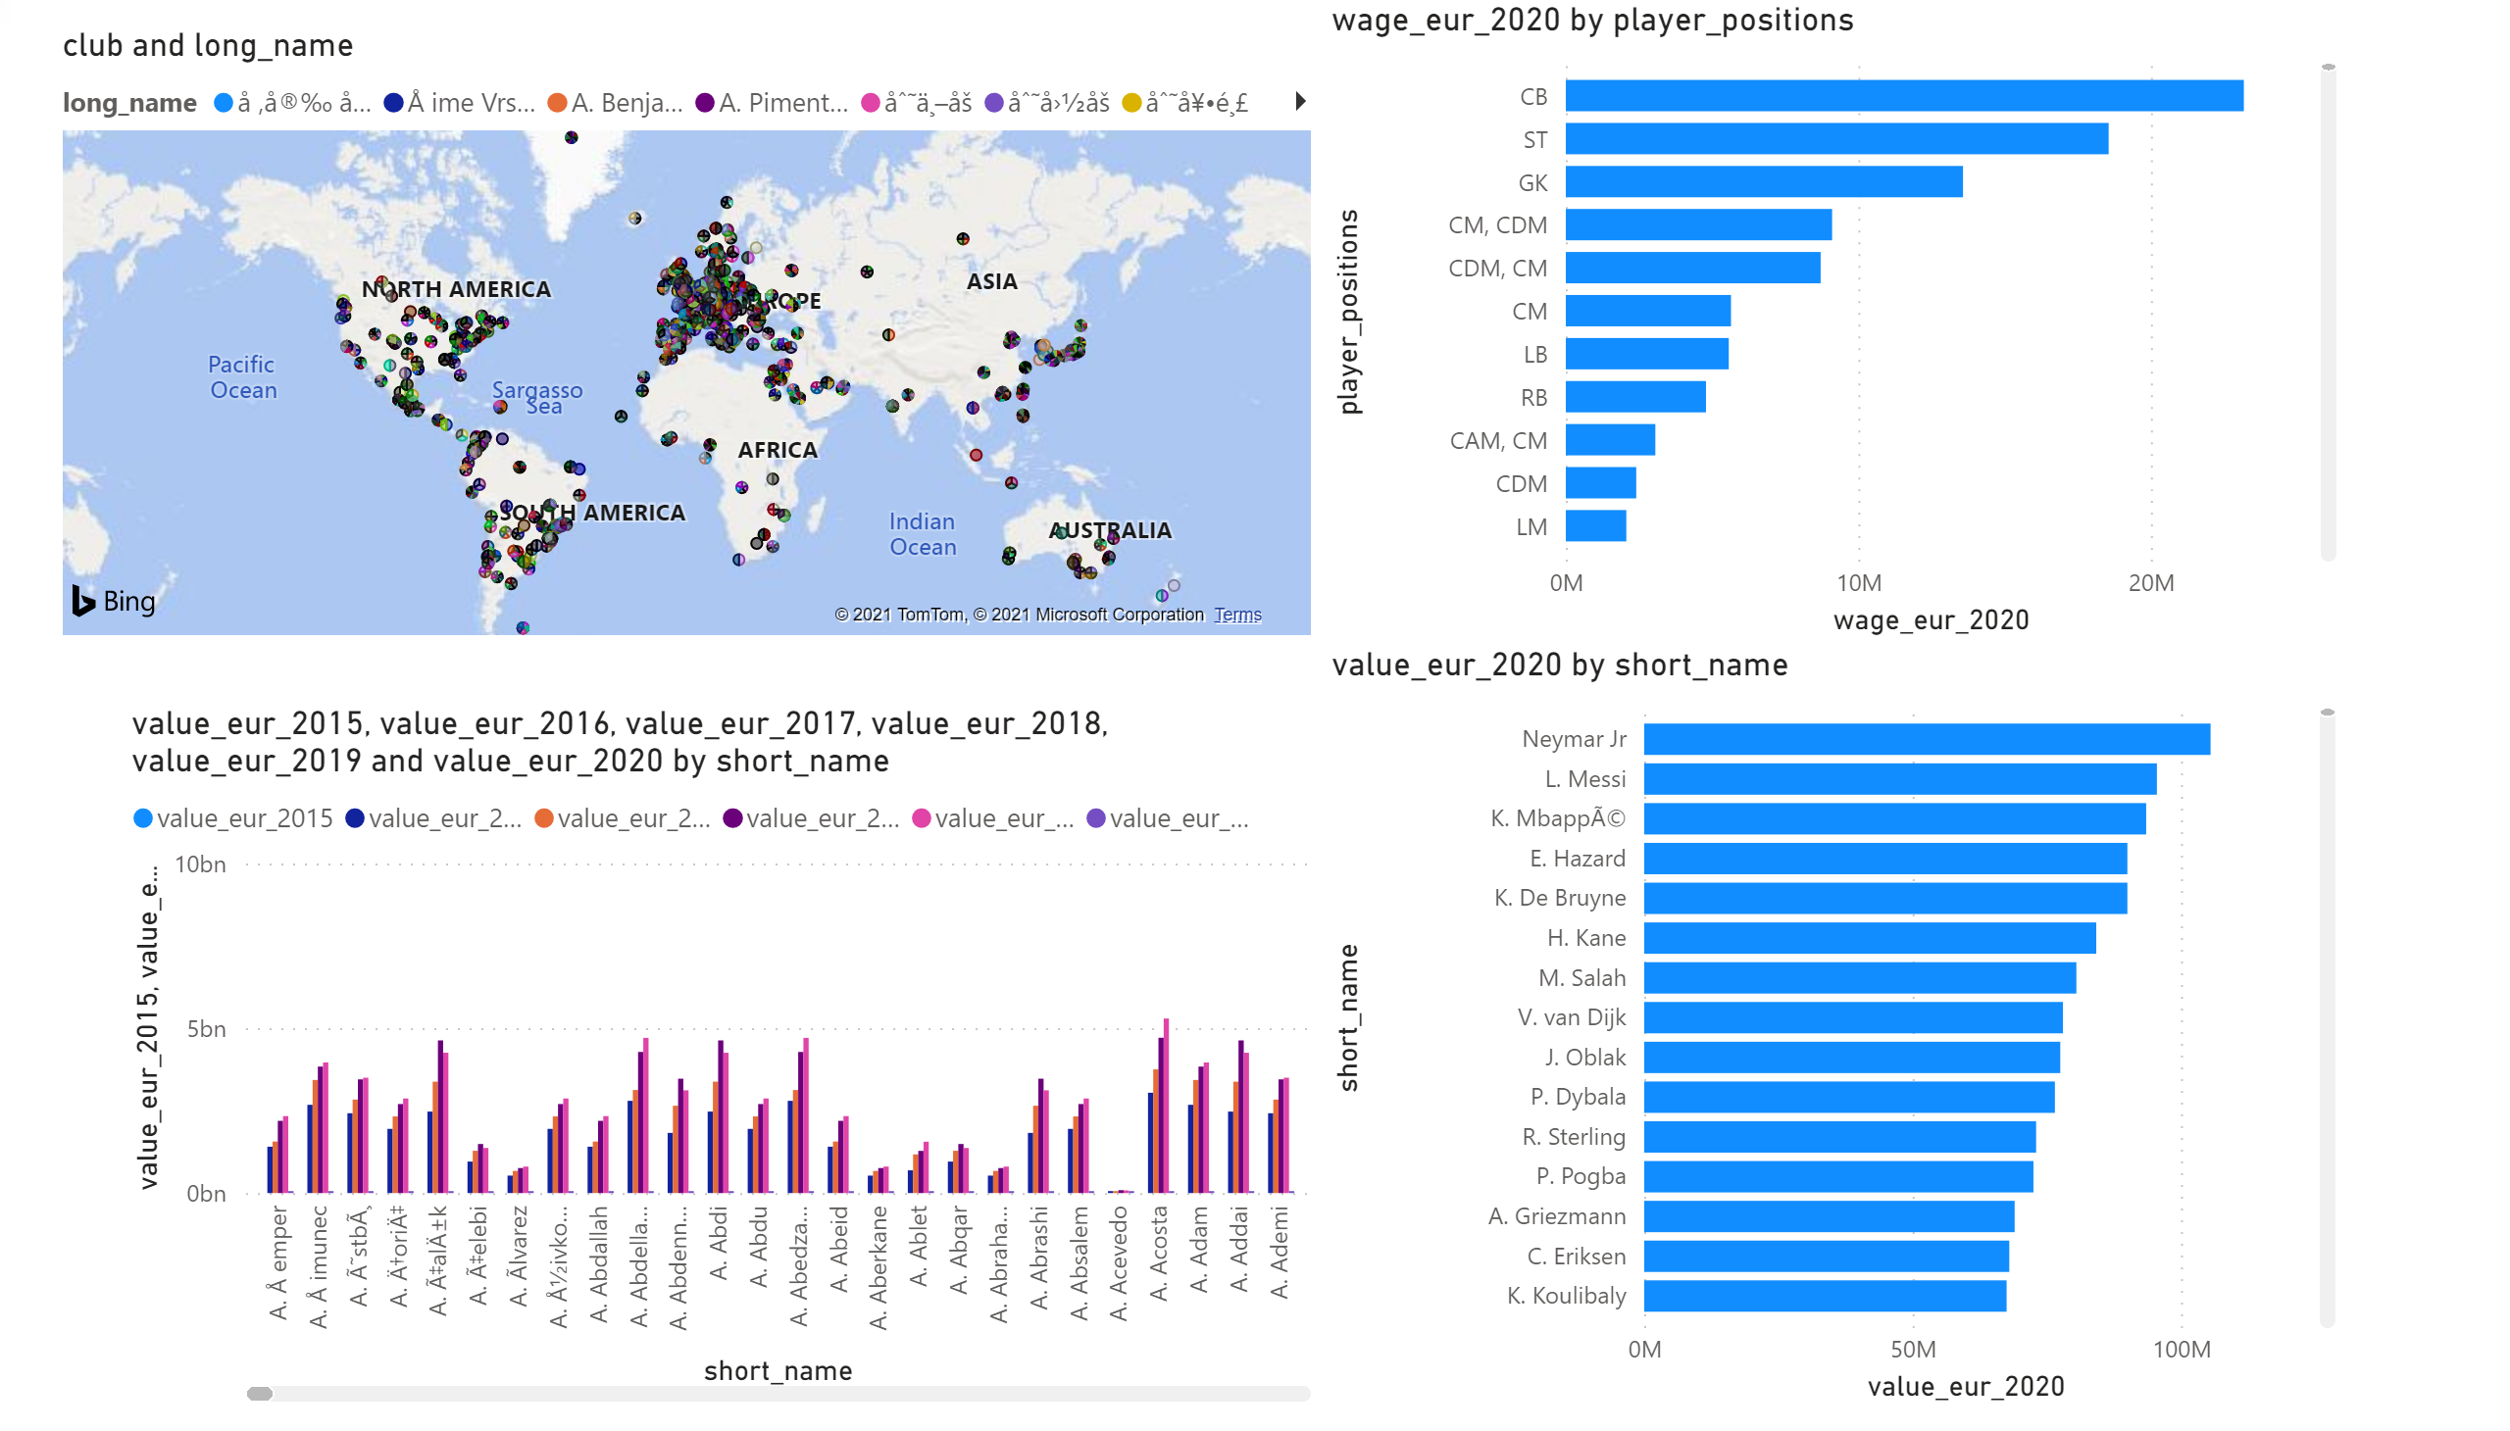
Page 1
Notes:
map
No alt text provided.
clusteredColumnChart
No alt text provided.
clusteredBarChart
No alt text provided.
clusteredBarChart
No alt text provided.

Slide 3
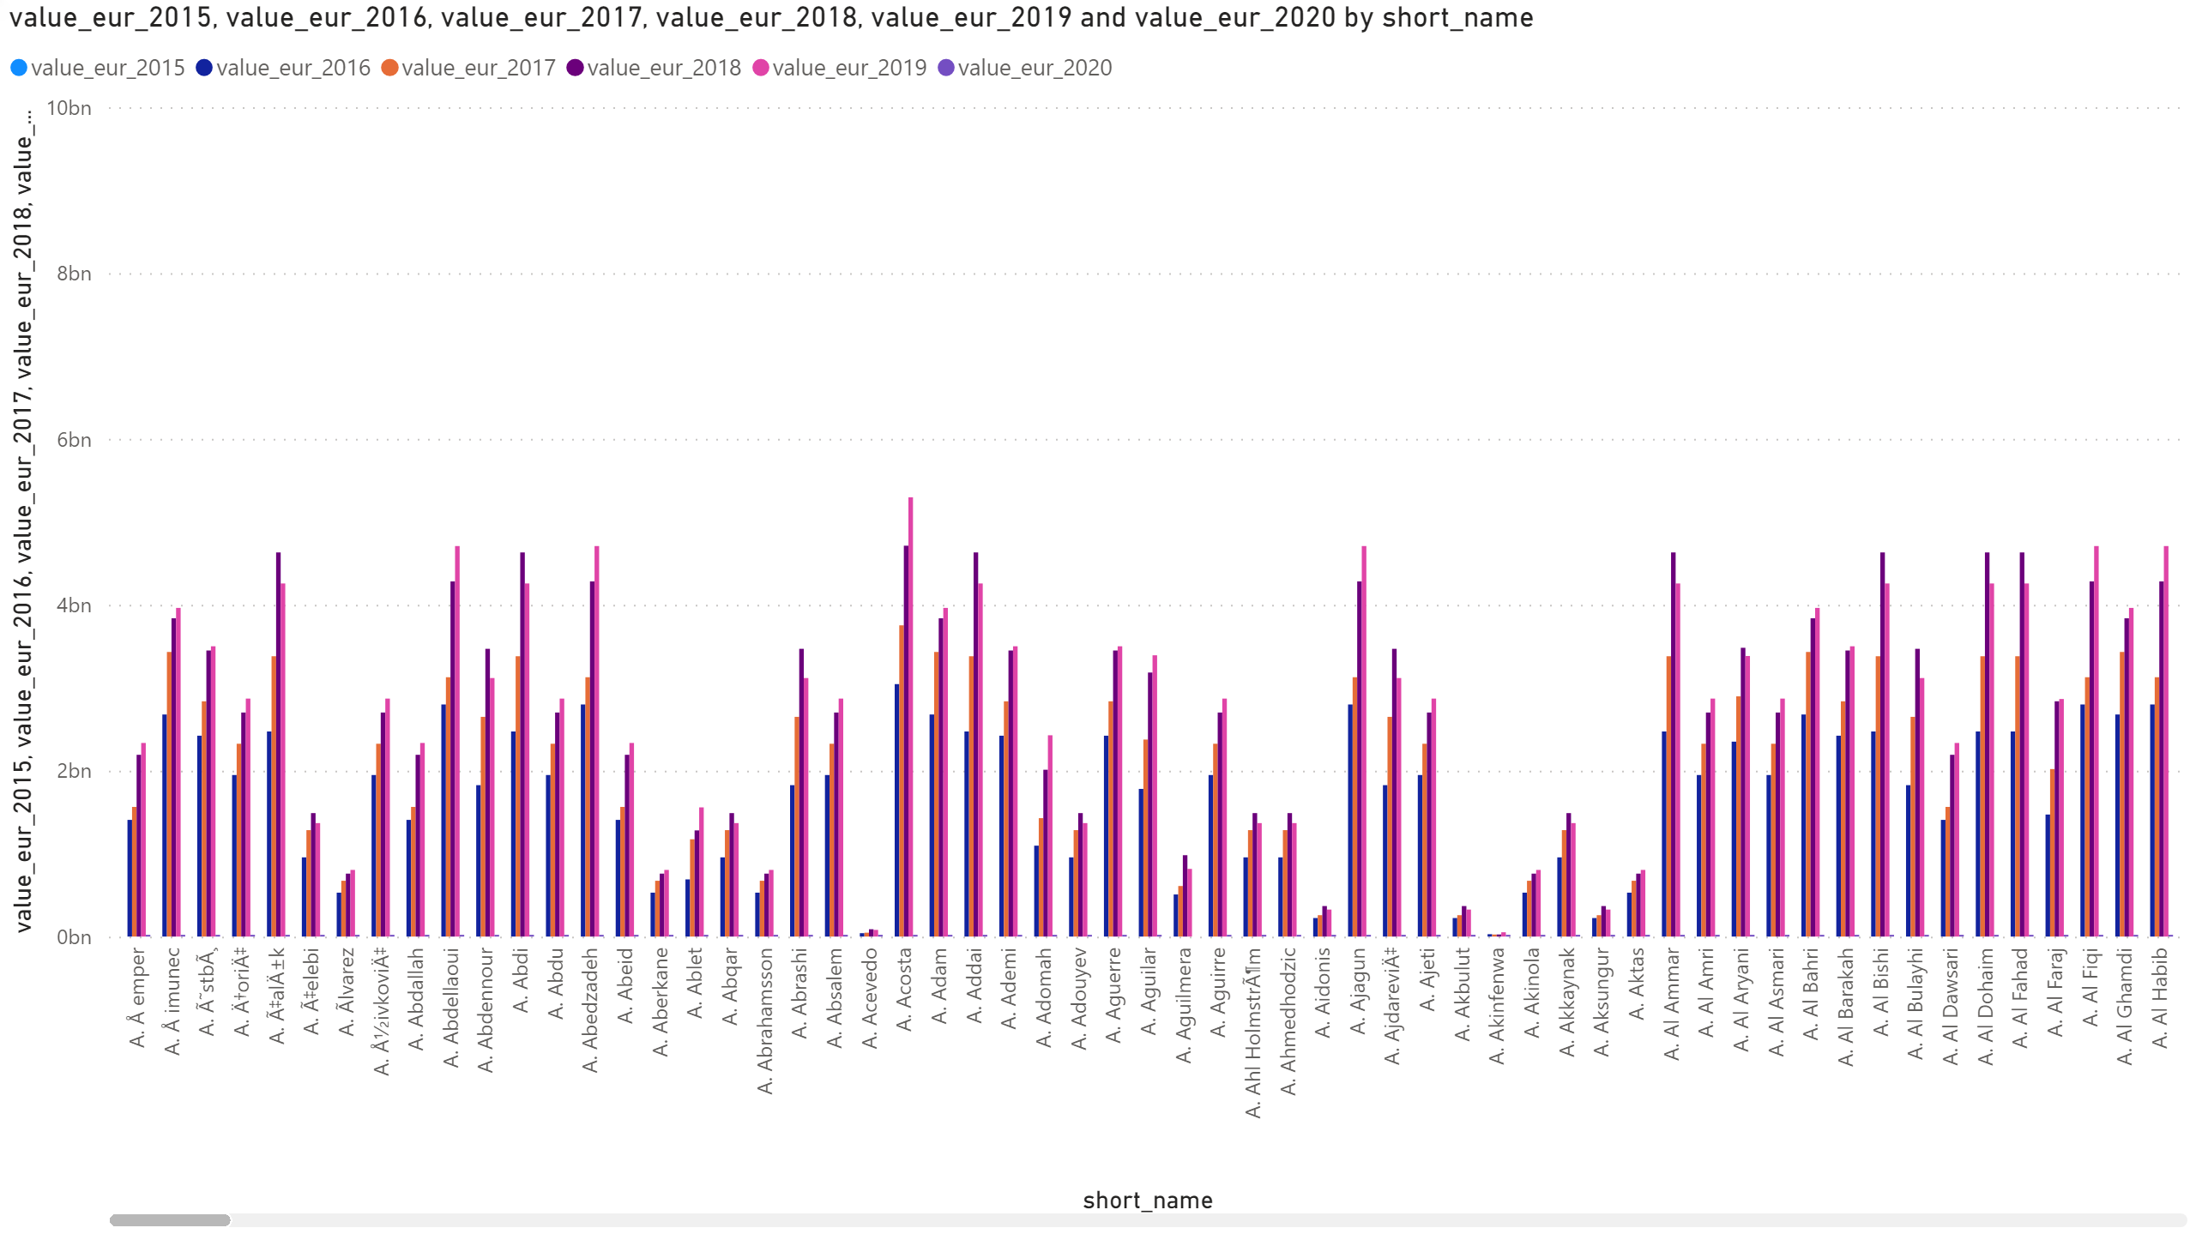
Page 2
Notes:
clusteredColumnChart
No alt text provided.

Slide 4
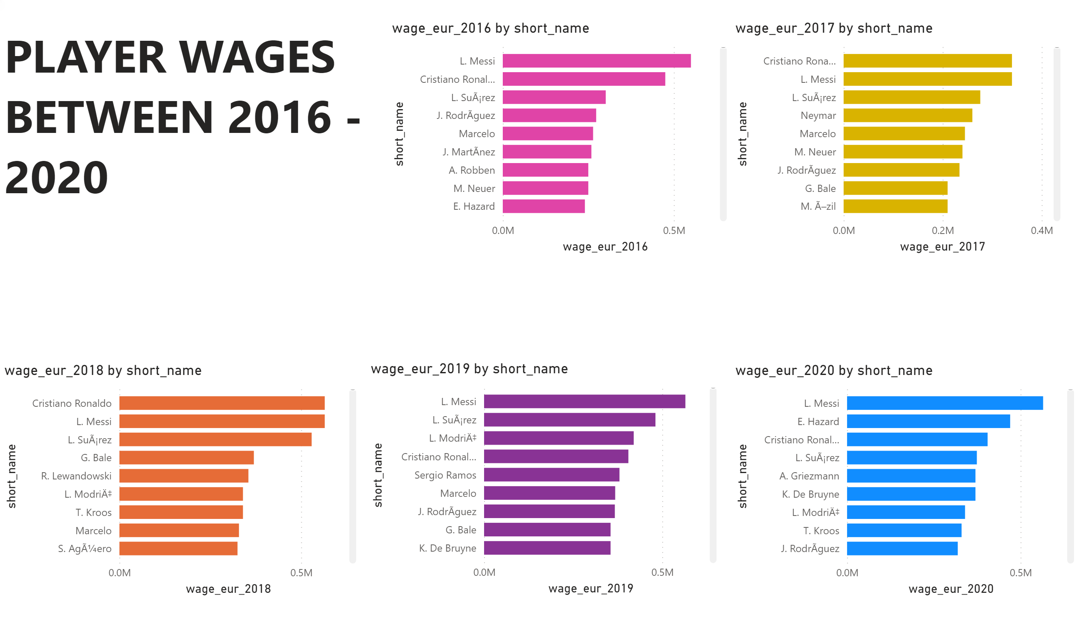
HIGHEST PAID PLAYERS
Notes:
clusteredBarChart
No alt text provided.
clusteredBarChart
No alt text provided.
clusteredBarChart
No alt text provided.
clusteredBarChart
No alt text provided.
clusteredBarChart
No alt text provided.
textbox
No alt text provided.

Slide 5
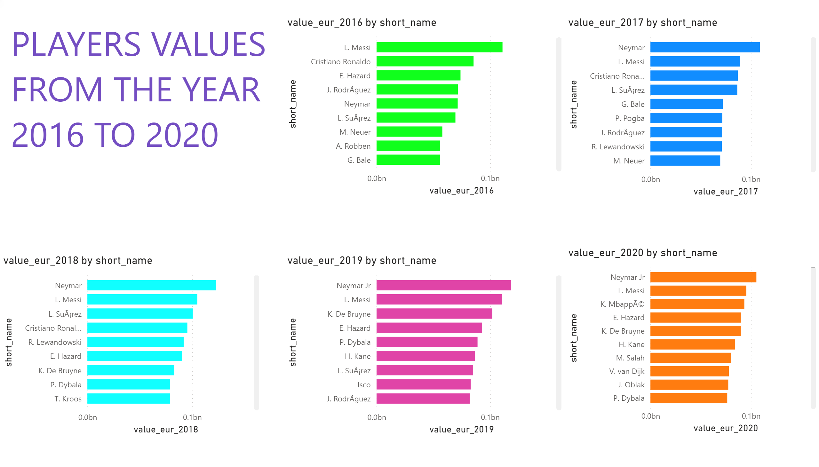
MOST VALUABLE PLAYERS
Notes:
textbox
No alt text provided.
clusteredBarChart
No alt text provided.
clusteredBarChart
No alt text provided.
clusteredBarChart
No alt text provided.
clusteredBarChart
No alt text provided.
clusteredBarChart
No alt text provided.

